Slide 1
High Resolution Dynamics of HABs
Jeff Hollister

Slide 2
Where, When
Shubael Pond and Hamblin Pond
Compliments SDR
A-pod
June to November
Started 2021

Slide 3
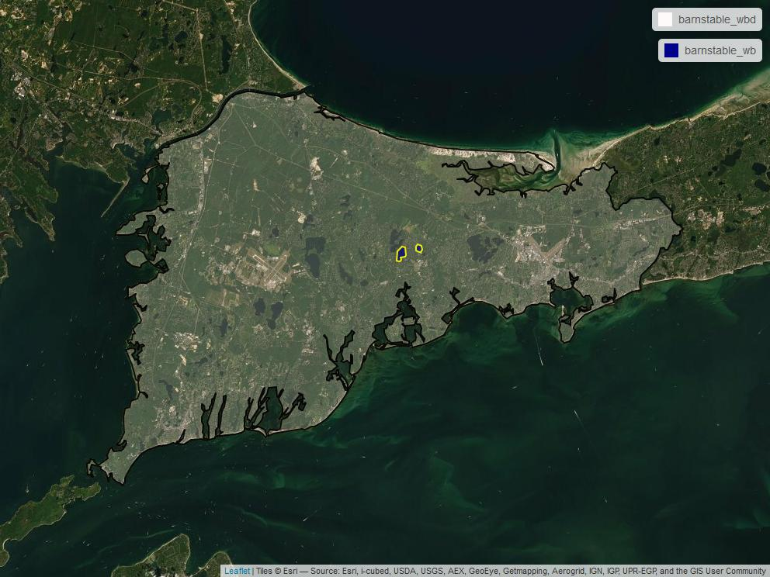

Slide 4
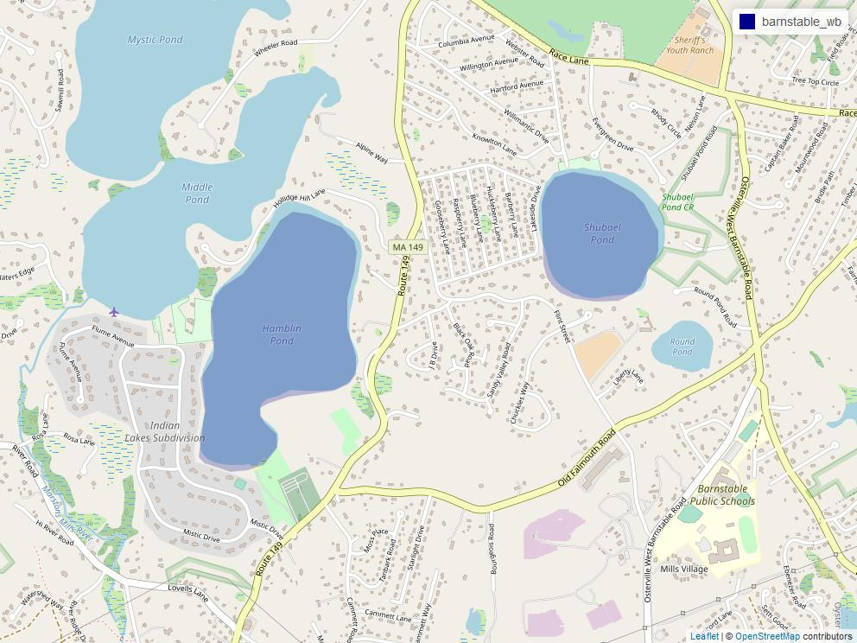

Slide 5
Why High Resolution?
Why High Resolution?
We know the general process
Don’t know fine scale triggers

Slide 6
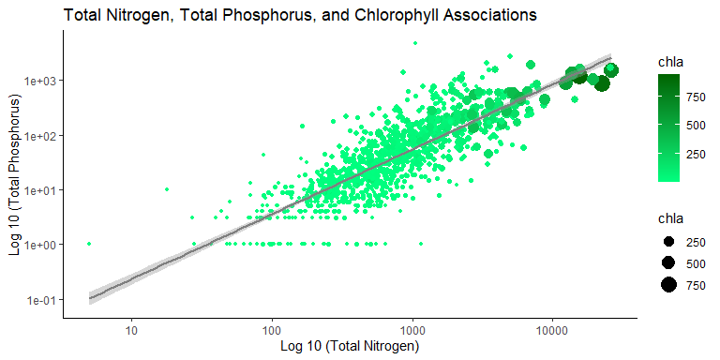

Slide 7
Why High Resolution?
Why High Resolution?
We know the general process
Don’t know fine scale triggers
Forecasting requires high resolution (e.g. )

Slide 8
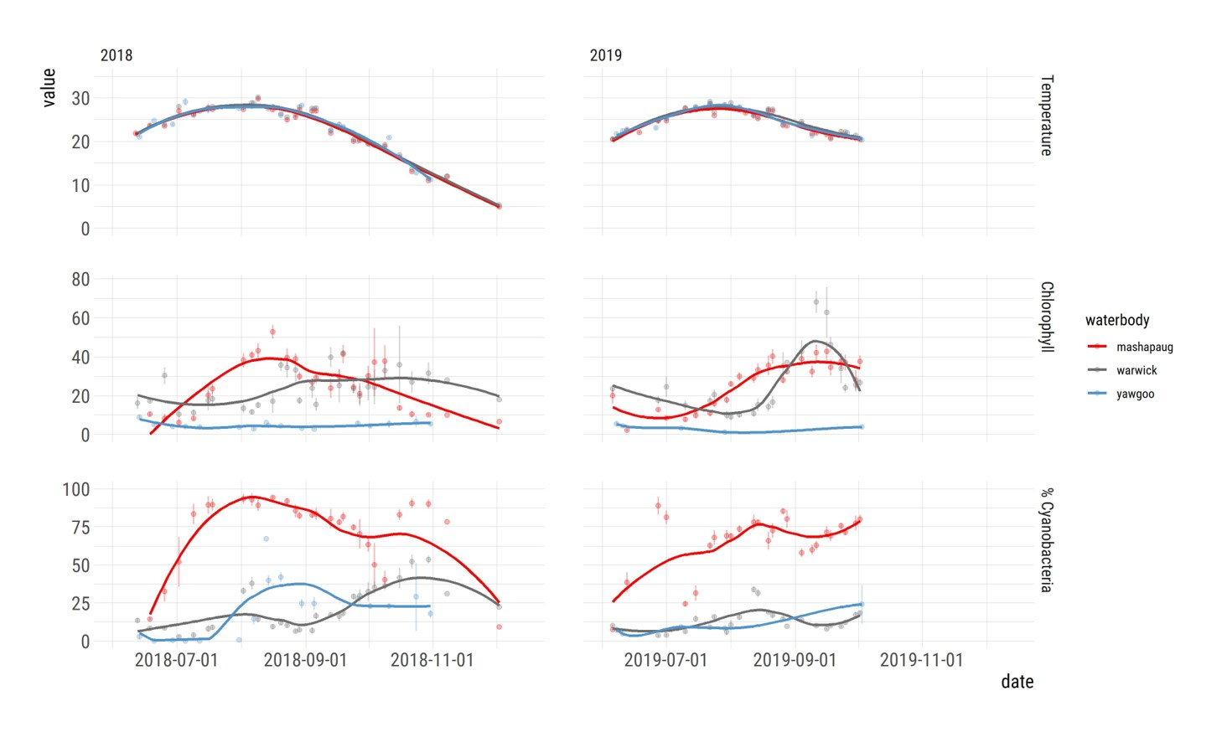

Slide 9
What: HABS over space
Fast Limnological Automated Measurments (FLAMe)
University of Wisconsin Center for Limnology: https://flame.wisc.edu
On-board flow through system
Multiparameter Sonde
Optical nitrate sensor
Measurements approx. every 20 meters
Twice a month
Work in progress!

Slide 10
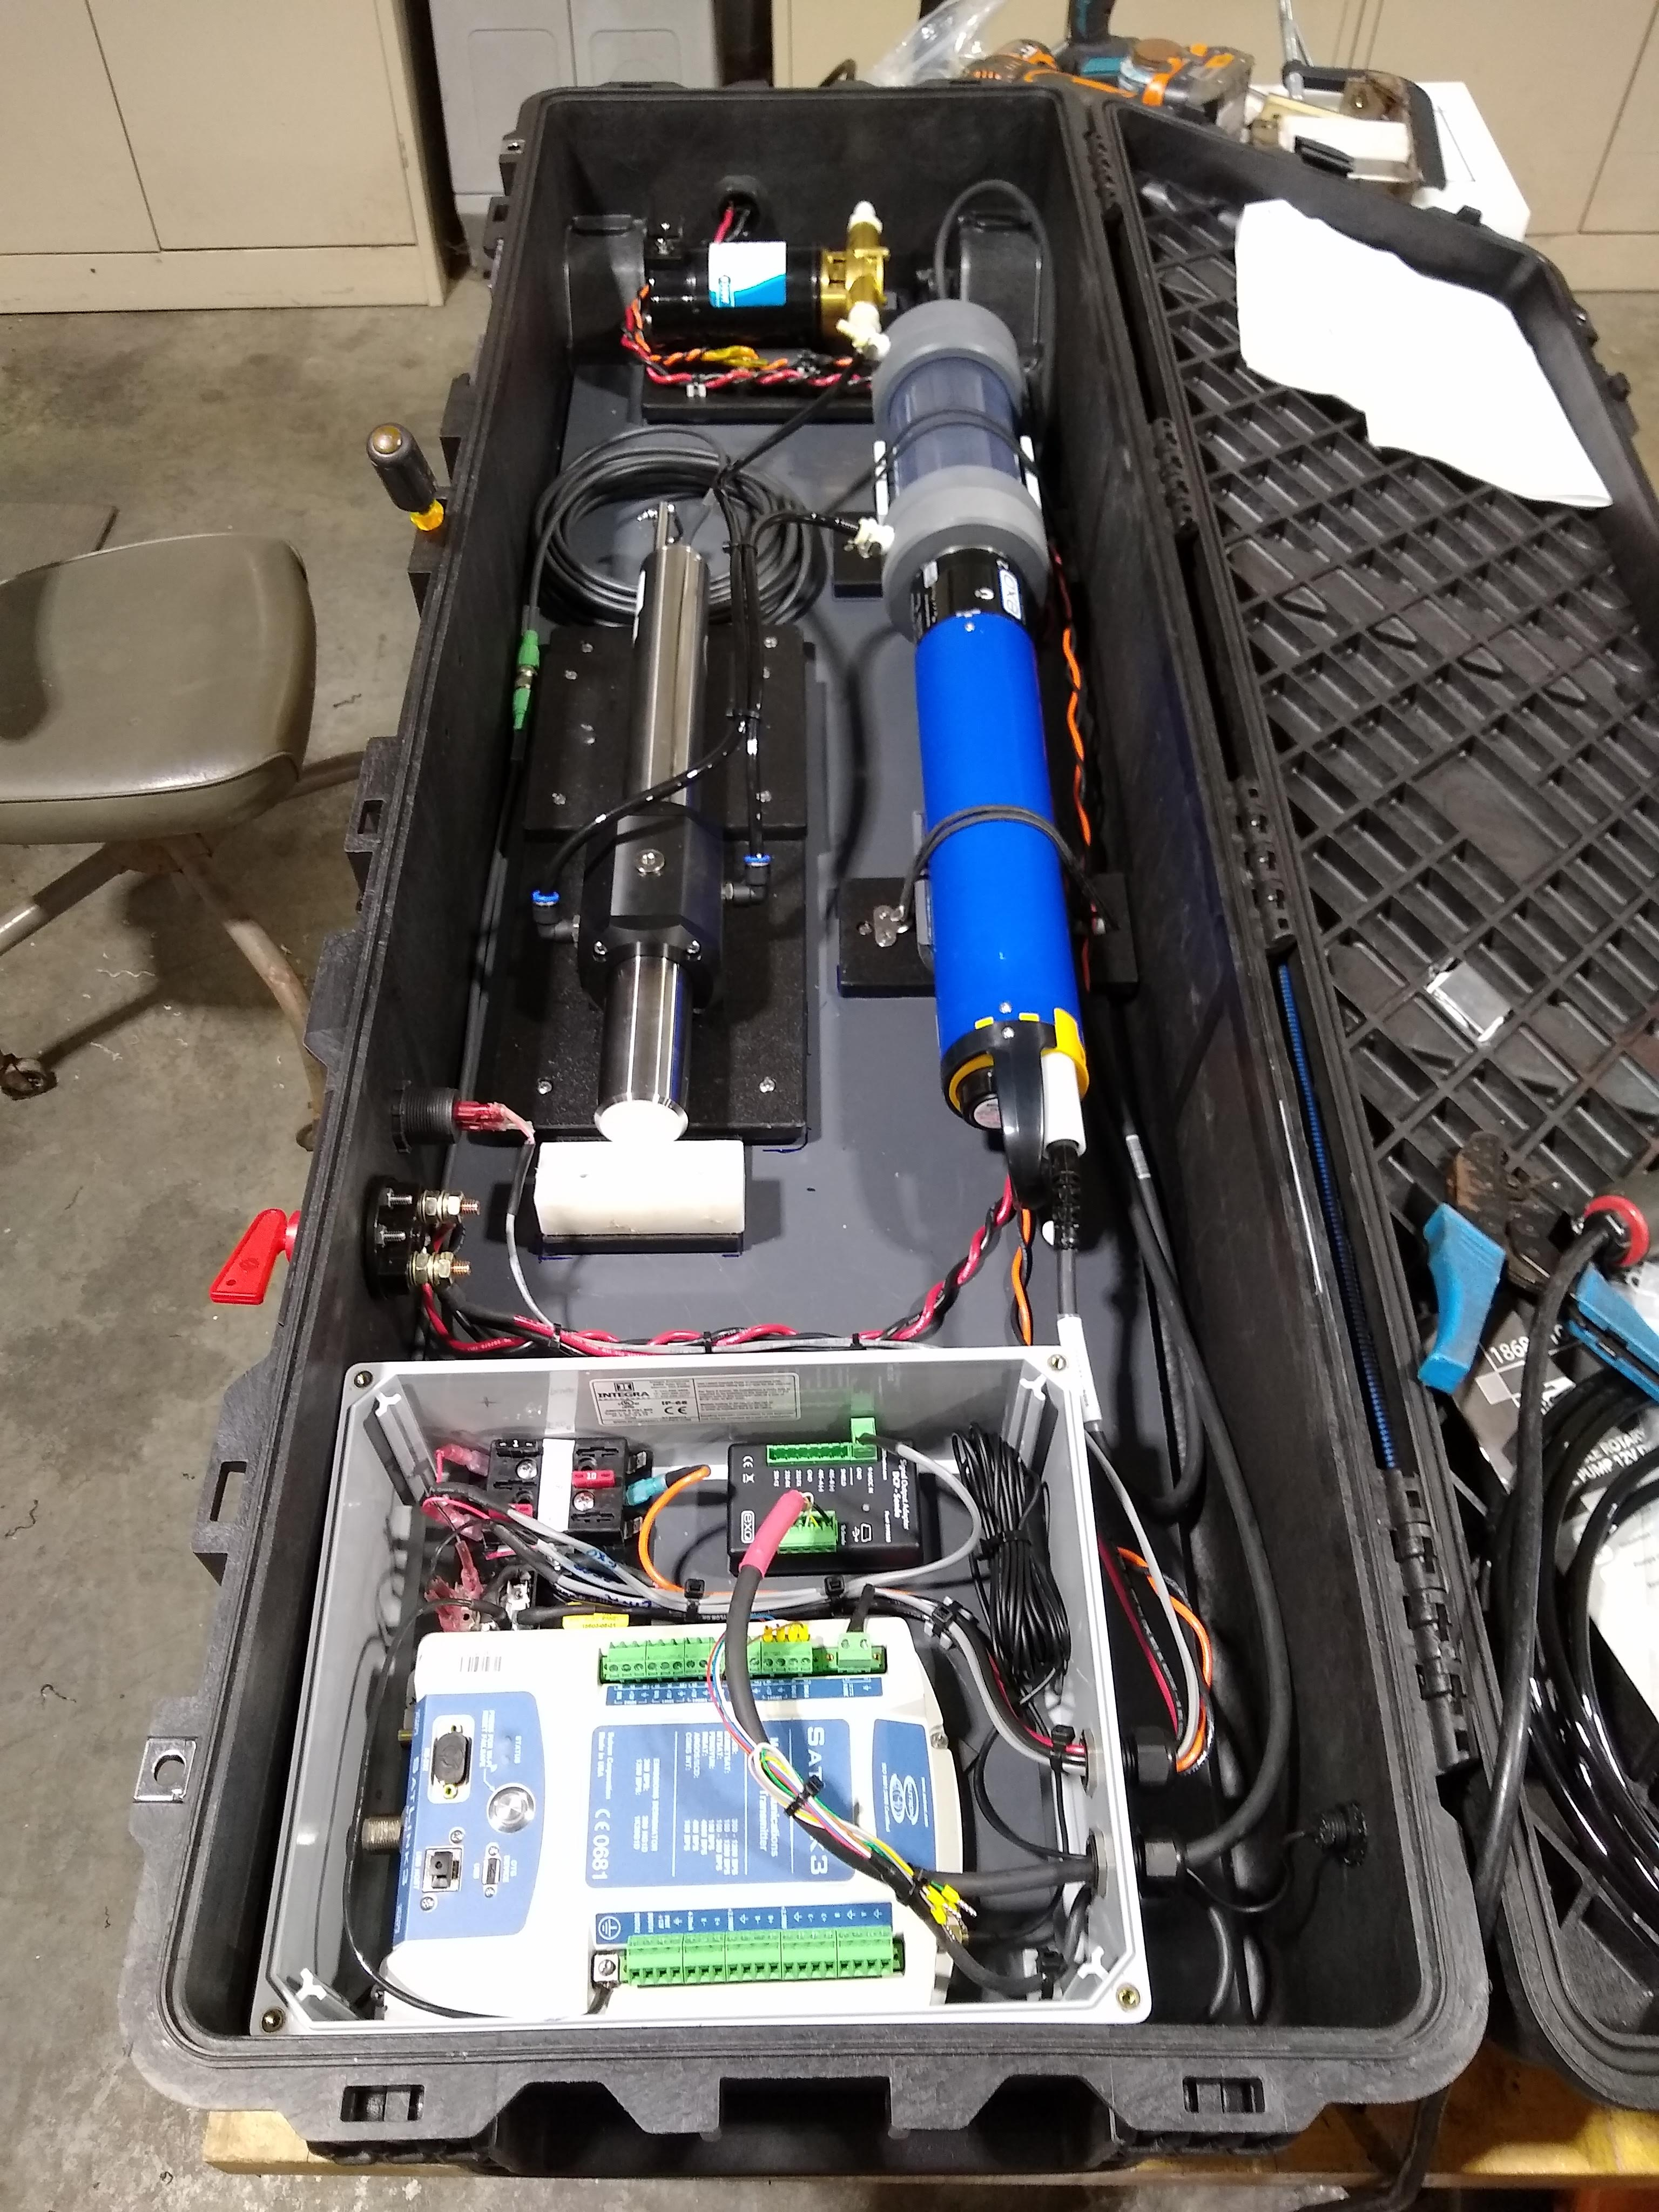

Slide 11
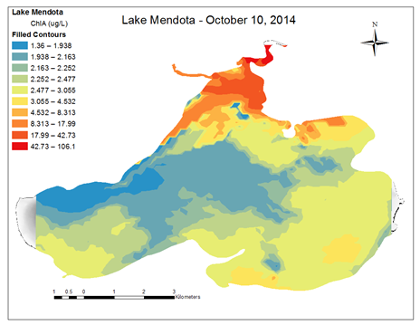

Slide 12
What: HABS over time
Buoys
Nexsens CB-150
Multiparameter sonde
Temperature, dissolved oxygen, pH, conductivity, tubirdity, FDOM, chlorophyll, phycocyanin
Optical nitrate sensor
Weather station
FieldKit Water with solar
Temperature, dissolved oxygen, pH, conductivity
Fixed location
Every 15 minutes

Slide 13
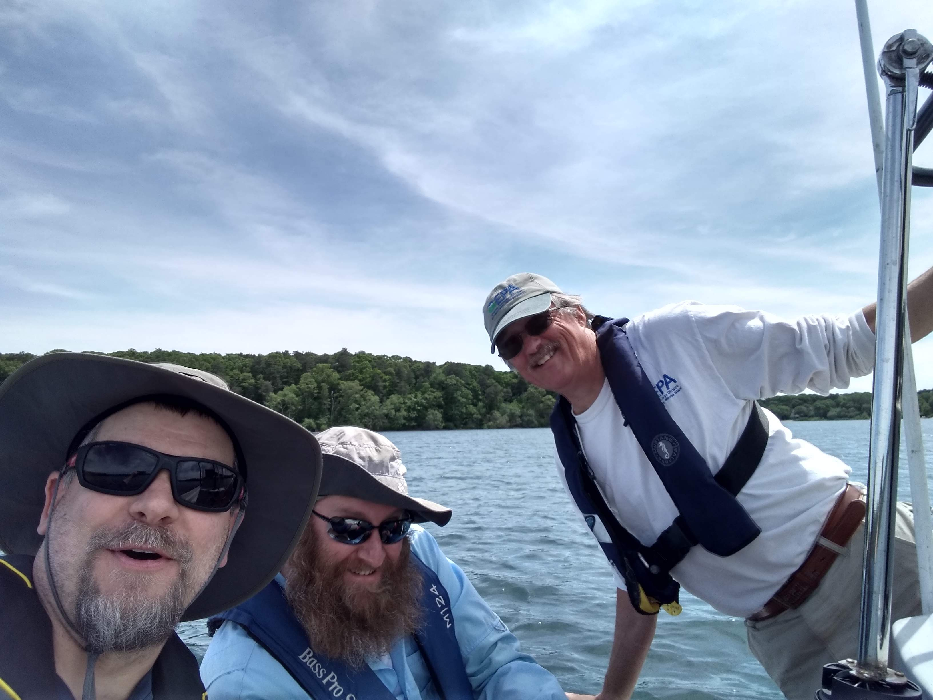

Slide 14
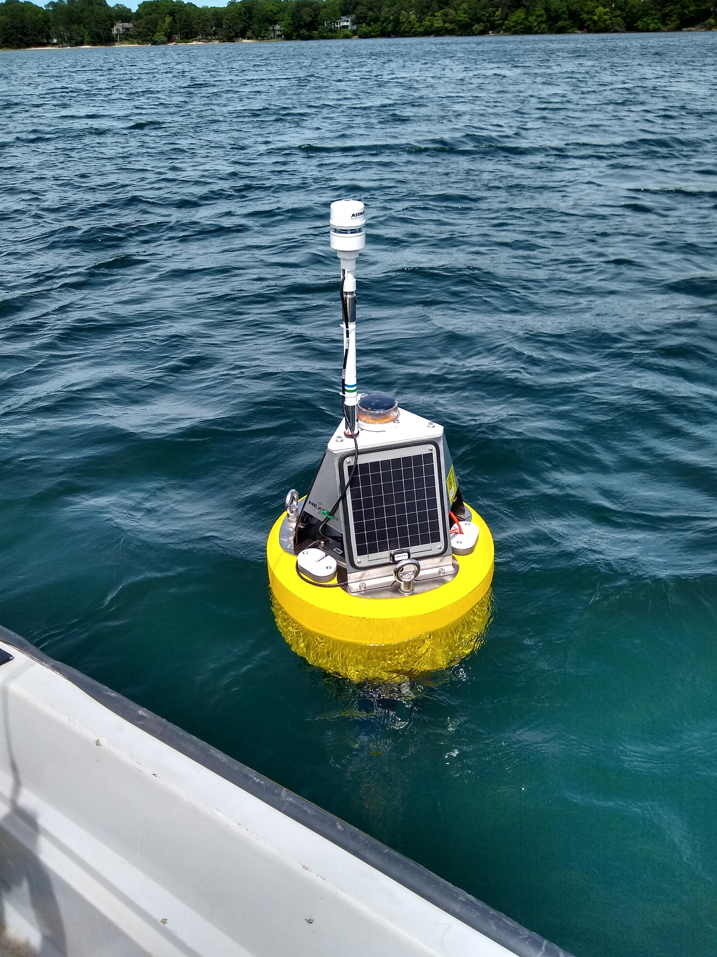

Slide 15
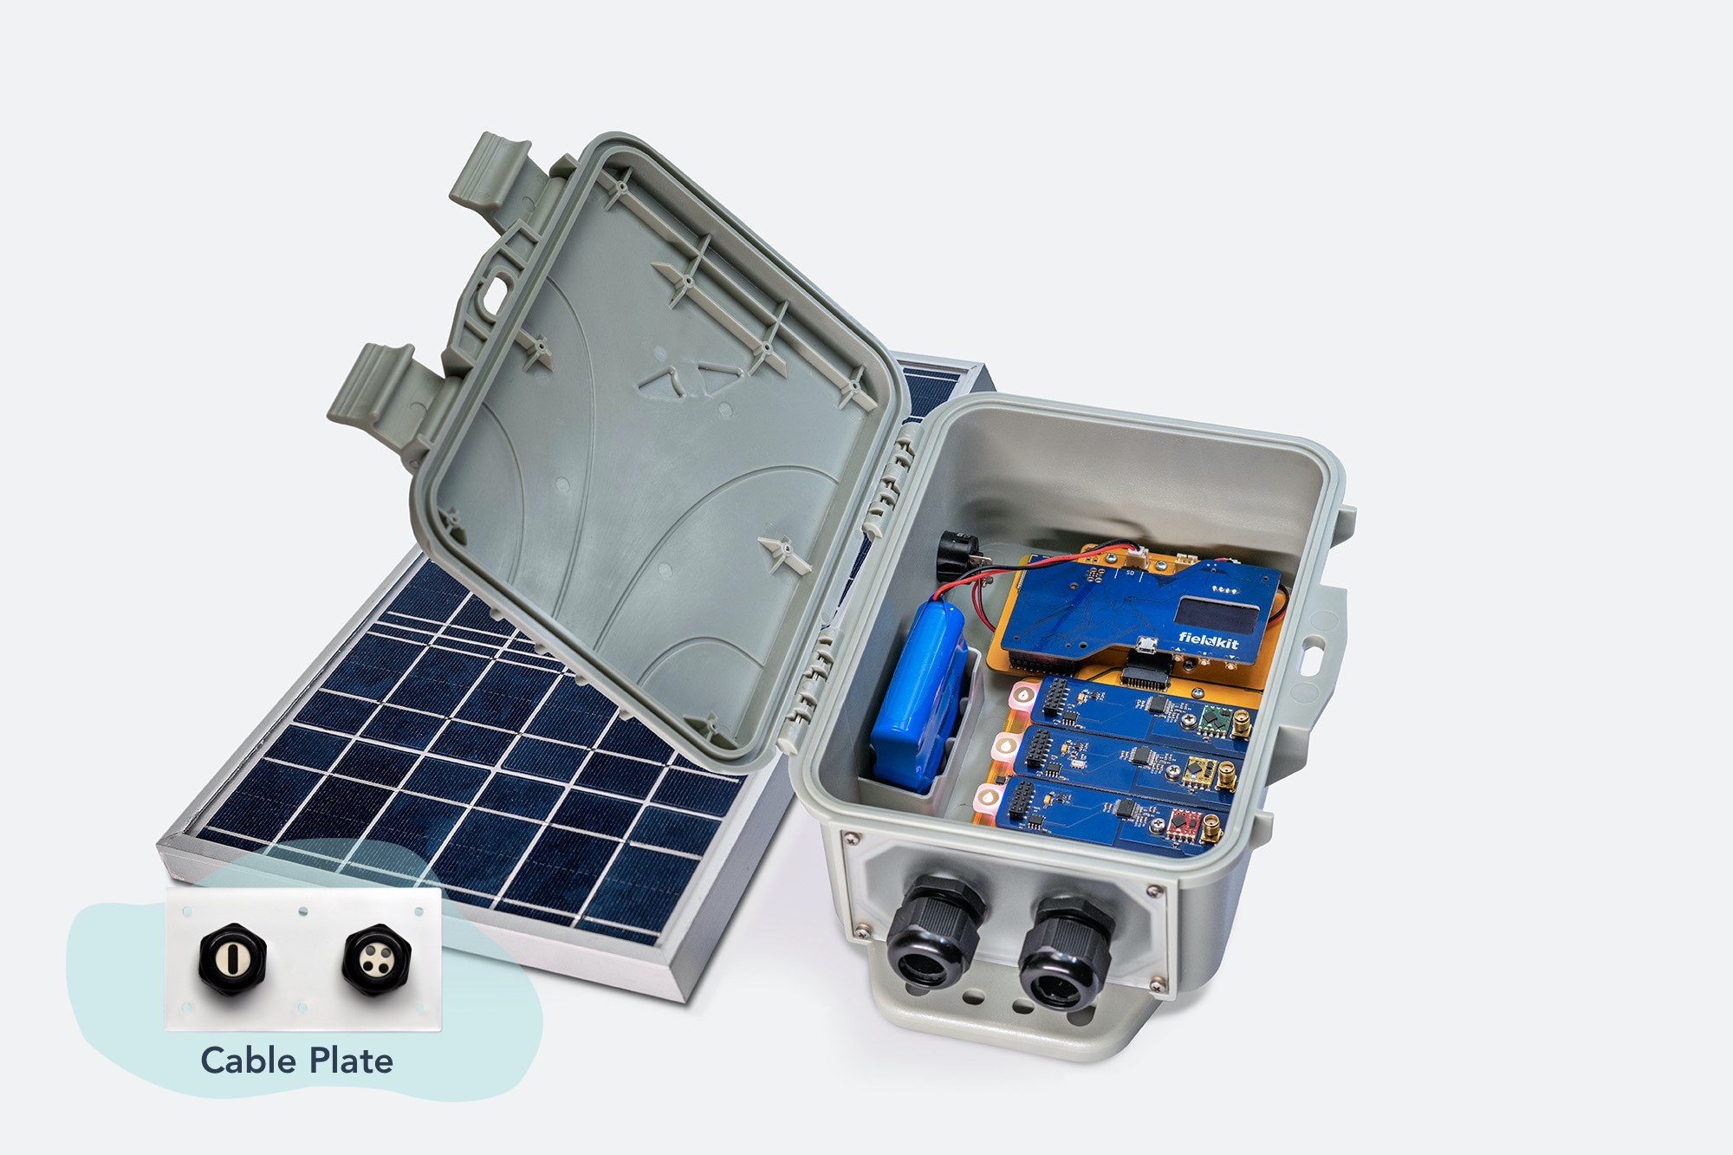

Slide 16
Preliminary Results
Shhhh

